Slide 1


Football Field
Reservation System
SUPERVISOR:
TEAM MEMBERS
Mr. Kiều Trọng Khánh
Mai Minh Quý – Leader
Trương Hữu Thành
Phan Minh Huấn
Phạm Trung Hiếu

Slide 2
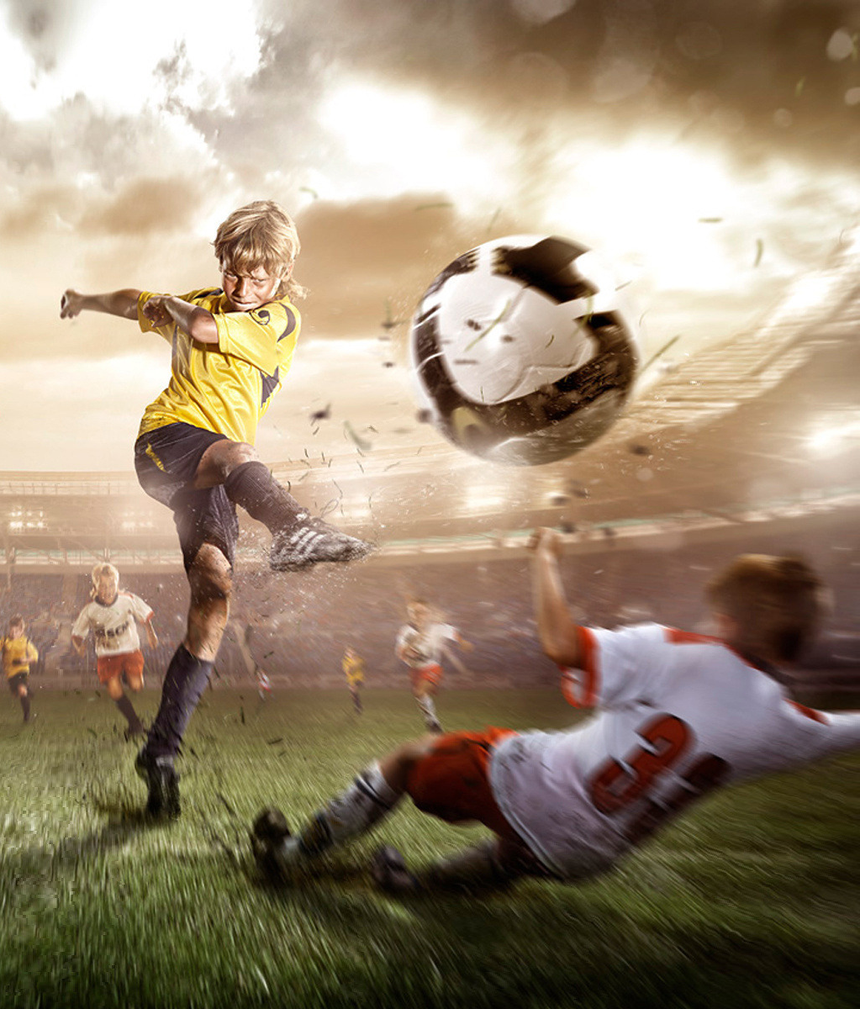
AGENDA
01
Introduction
02
Implementation
03
Values and Challenge
04
Future Plan
2

Slide 3
Part 1
Introduction

Slide 4
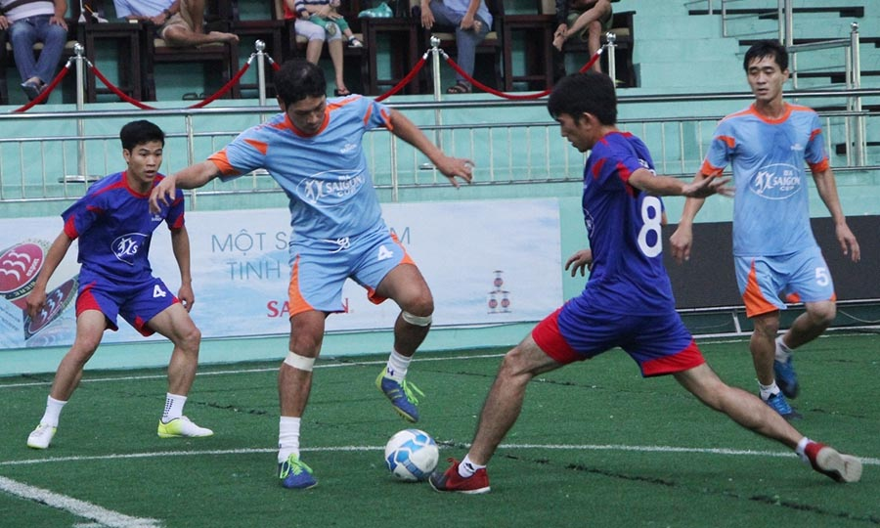
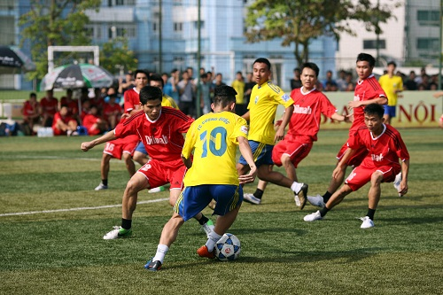
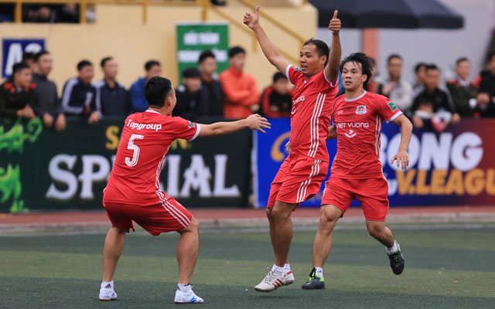
F
is an increasing trend
ootball
for all ages.
4

Slide 5
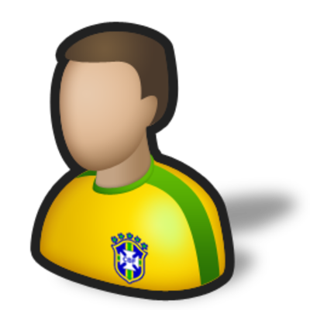
Scenario 1
Mr. Thành
5

Slide 6

Scenario 1
1. Calls or goes to field to reserve
Mr. Thành
Field Owner
6

Slide 7

Scenario 1
1. Calls or goes to field to reserve
2. Checks free time
Mr. Thành
Field Owner
7

Slide 8
Scenario 1
1. Calls or goes to field to reserve
2. Checks free time
3. Replies about reservation request
Mr. Thành
Field Owner
8

Slide 9
Scenario 1
1. Calls or goes to field to reserve
2. Checks free time
3. Replies about reservation request
4. Records reservation request on paper
Mr. Thành
Field Owner
9

Slide 10
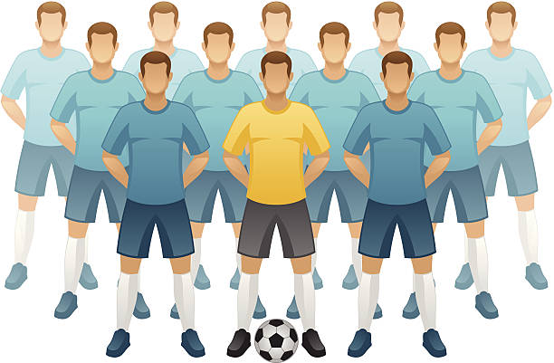
Scenario 1
1. Calls or goes to field to reserve
2. Checks free time
4. Replies about reservation request
3. Records reservation request on paper
Mr. Thành
Field Owner
5. Notifies to members in team
Team Member
10

Slide 11
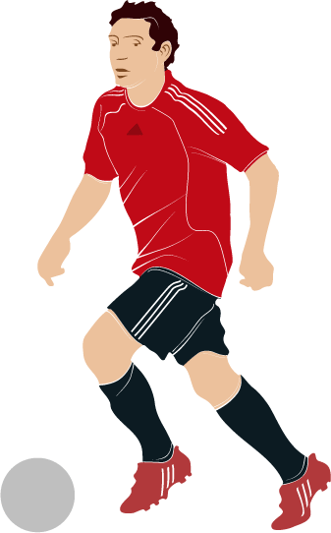
Scenario 1
1. Calls or goes to field to reserve
2. Checks free time
4. Replies about reservation request
3. Records reservation request on paper
Mr. Thành
Field Owner
5. Notifies to members in team
6. Go to field and kick-off
Team Member
11

Slide 12


Scenario 1
1. Calls or goes to field to reserve
2. Checks free time
4. Replies about reservation request
3. Records reservation request on paper
Mr. Thành
Field Owner
7. Pays cash
5. Notifies to members in team
Current Process
6. Go to field and kick-off
Team Member
12

Slide 13
Problems of Scenario 1
Calls or goes to field but free time of field is over
Try with another familiar fields but not found.
Wastes time but no results
Like football but can not play
Mr. Thành
13

Slide 14
Problems of Scenario 1
Calls or goes to field but free time of field is over
Try with another familiar fields but not found.
Wastes time but no results
Like football but can not play
Mr. Thành
Down mood, boring
14

Slide 15

Problems
Problems of Scenario 1
Calls or goes to field but free time of field is over
Try with another familiar fields but not found.
Wastes time but no results
Like football but can not play
Mr. Thành
- The field near home has free time but Mr. Thành doesn’t know and doesn’t like unfamiliar fields.
- During rush hours, finding a field becomes more difficult.
Down mood, boring
15

Slide 16

Problems of Scenario 1
Manages time schedule on paper should be easy to shortcomings
Field Owner
16

Slide 17

Problems of Scenario 1
Manages time schedule on paper should be easy to shortcomings
Spends a lot of time for answering the phone from customer
Field Owner
17

Slide 18

Problems of Scenario 1
Manages time schedule on paper should be easy to shortcomings
Spends a lot of time for answering the phone from customer
Field Owner
Finds customers passively because she does not have way to advertise football field
18

Slide 19
Problems of Scenario 1
Manages time schedule on paper should be easy to shortcomings
Spends a lot of time for answering the phone from customer
Field Owner
Finds customers passively because she does not have way to advertise football field
Does not have customers at idle hours
19

Slide 20
Problems of Scenario 1
Manages time schedule on paper should be easy to shortcomings
Spends a lot of time for answering the phone from customer
Field Owner
Find customers passively because she does not have way to advertise football field
Does not have customers at idle hours
Low income
20

Slide 21

Scenario 2
1. Mr. Thành does not have enough members to play football and want to find another team.
2. Mr. Thành’s football team want to play with another team to change mood.
Mr. Thành
21

Slide 22
Scenario 2
Mr. Thành
22

Slide 23
Scenario 2
1. Calls or goes field to propose matching opponent
Mr. Thành
Field Owner
23

Slide 24
Scenario 2
1. Calls or goes field to propose matching opponent
2. Checks free time
Mr. Thành
Field Owner
24

Slide 25

Scenario 2
1. Calls or goes field to propose matching opponent
2. Checks free time
3. Finds opponent
Mr. Thành
Field Owner
25

Slide 26
Scenario 2
1. Calls or goes field to propose matching opponent
2. Checks free time
4. Notifies about opponent
3. Finds opponent
Mr. Thành
Field Owner
26

Slide 27
Scenario 2
1. Calls or goes field to propose matching opponent
2. Checks free time
4. Notifies about opponent
3. Finds opponent
5. Confirms to play with suggested opponent
Mr. Thành
Field Owner
27

Slide 28
Scenario 2
Scenario 2
6. Notifies to opposing team
1. Calls or goes field to propose matching opponent
2. Checks free time
4. Notifies about opponent
3. Finds opponent
5. Confirms to play with suggested opponent
Mr. Thành
Field Owner
28

Slide 29
Scenario 2
Scenario 2
6. Notifies to opposing team
1. Calls or goes field to propose matching opponent
2. Checks free time
4. Notifies about opponent
3. Finds opponent
7. Records reservation request on paper
5. Confirms to play with suggested opponent
Mr. Thành
Field Owner
29

Slide 30
Scenario 2
6. Notifies to opposing team
1. Calls or goes field to propose matching opponent
2. Checks free time
4. Notifies about opponent
3. Finds opponent
7. Records reservation request on paper
5. Confirms to play with suggested opponent
Mr. Thành
Field Owner
8. Notifies to members in team
Team Member
30

Slide 31

Scenario 2
6. Notifies to opposing team
1. Calls or goes field to propose matching opponent
2. Checks free time
4. Notifies about opponent
3. Finds opponent
7. Records reservation request on paper
5. Confirms to play with suggested opponent
Mr. Thành
Field Owner
8. Notifies to members in team
9. Go to field and kick-off
Team Member
31

Slide 32


Scenario 2
6. Notifies to opposing team
1. Calls or goes field to propose matching opponent
2. Checks free time
4. Notifies about opponent
3. Finds opponent
7. Records reservation request on paper
5. Confirms to play with suggested opponent
Mr. Thành
Field Owner
10. Pays cash
8. Notifies to members in team
Current Process
9. Go to field and kick-off
Team Member
32

Slide 33
Problems of Scenario 2
Matching opponent is depended on the perspective of field owner.
Number of opponents is very small, only teams play same field.
33

Slide 34
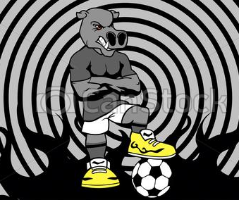
Problems of Scenario 2
Problems
Matching opponent is depended on the perspective of field owner.
Number of opponents is very small, only teams play same field.
- Opponent has bad attitude.
- Have too big difference about level
34

Slide 35
Problems of Scenario 2
Matching opponent is depended on the perspective of field owner.
Number of opponents is very small, only teams play same field.
- Opponent has bad attitude.
- Have too big difference about level
The match does not meet player’s expectation
35

Slide 36

Our idea
requests
Mr. Thành
Field Owner
FFRS is the bridge between the field owner and player.
36

Slide 37
Our idea
requests
responses
Mr. Thành
Field Owner
FFRS is the bridge between the field owner and player.
37

Slide 38
Our idea
requests
notifies
responses
Mr. Thành
Field Owner
FFRS is the bridge between the field owner and player.
38

Slide 39
Our idea
requests
notifies
responses
Mr. Thành
approves
Field Owner
FFRS is the bridge between the field owner and player.
39

Slide 40
Our idea
requests
notifies
responses
Mr. Thành
approves
Field Owner
notifies
notifies
FFRS is the bridge between the field owner and player.
40

Slide 41
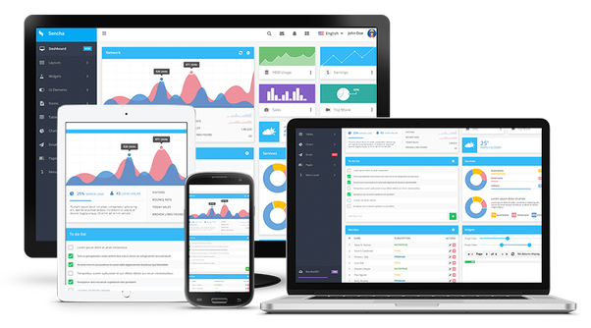

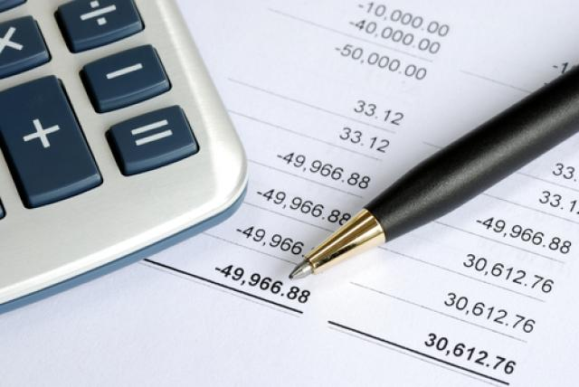

For field owner
Web Application
Provide promotion for advertising
Manage field, time quickly and effectively
Manage profit easily
41

Slide 42
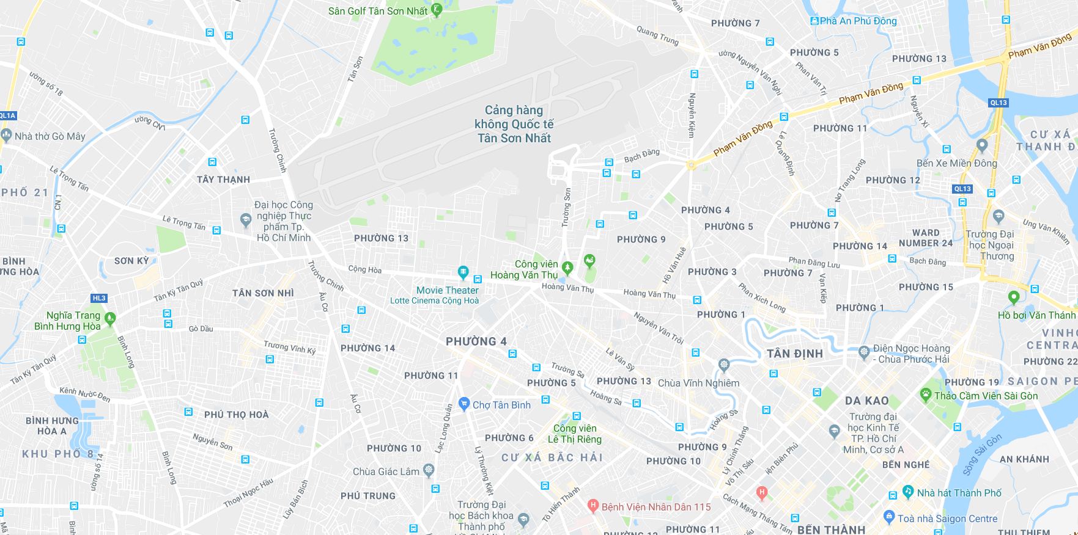



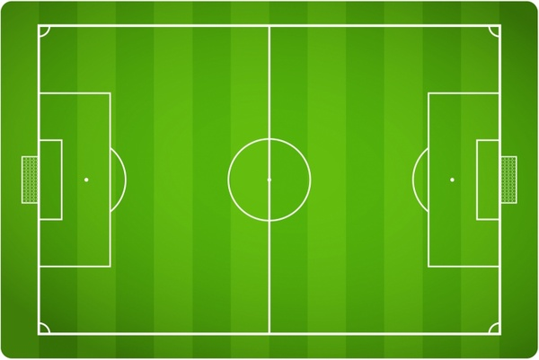


For players
Mobile Application
Reserve field and pay online
Search field by position,
by name
Find the suitable opponent
42

Slide 43
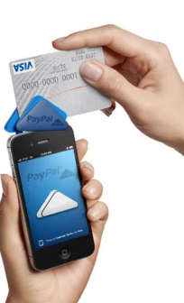
Supports
Online Payment
Notify to member
43

Slide 44


User
User has passionate about football and use reservation services
Field Owner has football fields and provide reservation services
Staff is a member of FFR, he/she manages the general and solves problems for user and field owner
Admin is a member of FFR, he/she manages staff account and lock/unlock account
44

Slide 45
Part 2
Implementation

Slide 46
Architecture
Web Application
Server
Send HTTP Request
Middleware
API
Send HTTP Response
Reducer
Business Logic
Store
DAO
Manipulate
Database

Slide 47
Mobile Application
Architecture
Server
Send HTTP Request
Activity
API
Send HTTP Response
Model
Business Logic
DAO
Manipulate
Database

Slide 48
Scenario
Field 1
Field Owner Cây Trâm has 3 working field :
Field 1, Field 2, Field 3
Field 2
Field Owner Cây Trâm
Field 3
48

Slide 49




Scenario
1. Mr. Huấn 07h – 09h
2.Mr. Hiếu
10h – 13h
3.Mr. Trung 07h – 10h
6. Mr. Quý
09h – 13h
Field Owner Cây Trâm
4. Mr. Thành 08h – 11h
5. Mr. Thành 11h – 13h
49

Slide 50
Cây Trâm Football Field
Algorithms
Algorithms
Arrange Time
Algorithms
Algorithms
Request 1: 07h – 09h
Request 2: 10h - 13h
Request 3: 07h – 10h
Request 4: 08h – 11h
Request 5:11h – 13h
Request 6:09h – 13h
Field 1
Field 2
Field 3
07h – 08h
08h – 09h
09h – 10h
10h – 11h
11h – 12h
12h – 13h
50

Slide 51
Cây Trâm Football Field
Algorithms
Algorithms
Arrange Time
Algorithms
Algorithms
Request 1: 07h – 09h
Field 1
Field 2
Field 3
07h – 08h
08h – 09h
09h – 10h
10h – 11h
11h – 12h
12h – 13h
51

Slide 52
Cây Trâm Football Field
Algorithms
Algorithms
Arrange Time
Algorithms
Algorithms
Request 1: 07h – 09h
Request 2: 10h - 13h
Field 1
Field 2
Field 3
07h – 08h
08h – 09h
09h – 10h
10h – 11h
11h – 12h
12h – 13h
52

Slide 53
Cây Trâm Football Field
Algorithms
Algorithms
Arrange Time
Algorithms
Algorithms
Request 1: 07h – 09h
Request 2: 10h - 13h
Request 3: 07h – 10h
Field 1
Field 2
Field 3
07h – 08h
08h – 09h
09h – 10h
10h – 11h
11h – 12h
12h – 13h
53

Slide 54
Cây Trâm Football Field
Algorithms
Algorithms
Arrange Time
Algorithms
Algorithms
Request 1: 07h – 09h
Request 2: 10h - 13h
Request 3: 07h – 10h
Request 4: 08h – 11h
Field 1
Field 2
Field 3
07h – 08h
08h – 09h
09h – 10h
10h – 11h
11h – 12h
12h – 13h
54

Slide 55
Cây Trâm Football Field
Algorithms
Algorithms
Arrange Time
Algorithms
Algorithms
Request 1: 07h – 09h
Request 2: 10h - 13h
Request 3: 07h – 10h
Request 4: 08h – 11h
Request 5:11h – 13h
Field 1
Field 2
Field 3
07h – 08h
08h – 09h
09h – 10h
10h – 11h
11h – 12h
12h – 13h
55

Slide 56
Cây Trâm Football Field
Algorithms
Algorithms
Arrange Time
Algorithms
Algorithms
Request 1: 07h – 09h
Request 2: 10h - 13h
Request 3: 07h – 10h
Request 4: 08h – 11h
Request 5:11h – 13h
Request 6:09h – 13h
Field 1
Field 2
Field 3
07h – 08h
08h – 09h
09h – 10h
10h – 11h
11h – 12h
12h – 13h
56

Slide 57
How the system can arranges time ?
Algorithms
Algorithms
Arrange Time
Algorithms
Algorithms
57

Slide 58
Cây Trâm Football Field
Algorithms
Algorithms
Arrange Time
Algorithms
Algorithms
Request 1: 07h – 09h
Request 2: 10h - 13h
Request 3: 07h – 10h
Request 4: 08h – 11h
Request 5:11h – 13h
Request 6:09h – 13h
Field 1
Field 2
Field 3
07h – 08h
08h – 09h
09h – 10h
10h – 11h
11h – 12h
12h – 13h
58

Slide 59
Summary: Every field is the same, so we can put request 6 into Field 2, or Field 3 by swap all requests was set to Field 1 => We only need to manage free time of all fields, no matter what the request is placed
Algorithms
Algorithms
Arrange Time
Algorithms
Algorithms
59

Slide 60
Cây Trâm Football Field
Algorithms
Algorithms
Arrange Time
Algorithms
Algorithms
Time slot
Time slot
Time Slot
07h – 08h
08h – 09h
09h – 10h
10h – 11h
11h – 12h
12h – 13h
60

Slide 61
Cây Trâm Football Field
Algorithms
Algorithms
Arrange Time
Algorithms
Algorithms
Request 1: 07h – 09h
Time slot
Time slot
Time Slot
07h – 08h
08h – 09h
09h – 10h
10h – 11h
11h – 12h
12h – 13h
61

Slide 62
Cây Trâm Football Field
Algorithms
Algorithms
Arrange Time
Algorithms
Algorithms
Request 1: 07h – 09h
Time slot
Time slot
Time Slot
07h – 08h
08h – 09h
09h – 10h
10h – 11h
11h – 12h
12h – 13h
62

Slide 63
Cây Trâm Football Field
Algorithms
Algorithms
Arrange Time
Algorithms
Algorithms
Request 1: 07h – 09h
Request 2: 10h - 13h
Time slot
Time slot
Time Slot
07h – 08h
08h – 09h
09h – 10h
10h – 11h
11h – 12h
12h – 13h
63

Slide 64
Cây Trâm Football Field
Algorithms
Algorithms
Arrange Time
Algorithms
Algorithms
Request 1: 07h – 09h
Request 2: 10h - 13h
Time slot
Time slot
Time Slot
07h – 08h
08h – 09h
09h – 10h
10h – 11h
11h – 12h
12h – 13h
64

Slide 65
Cây Trâm Football Field
Algorithms
Algorithms
Arrange Time
Algorithms
Algorithms
Request 1: 07h – 09h
Request 2: 10h - 13h
Request 3: 07h – 10h
Time slot
Time slot
Time Slot
07h – 08h
08h – 09h
09h – 10h
10h – 11h
11h – 12h
12h – 13h
65

Slide 66
Cây Trâm Football Field
Algorithms
Algorithms
Arrange Time
Algorithms
Algorithms
Request 1: 07h – 09h
Request 2: 10h - 13h
Request 3: 07h – 10h
Time slot
Time slot
Time Slot
07h – 08h
08h – 09h
09h – 10h
10h – 11h
11h – 12h
12h – 13h
66

Slide 67
Cây Trâm Football Field
Algorithms
Algorithms
Arrange Time
Algorithms
Algorithms
Request 1: 07h – 09h
Request 2: 10h - 13h
Request 3: 07h – 10h
Request 4: 08h – 11h
Time slot
Time slot
Time Slot
07h – 08h
08h – 09h
09h – 10h
10h – 11h
11h – 12h
12h – 13h
67

Slide 68
Cây Trâm Football Field
Algorithms
Algorithms
Arrange Time
Algorithms
Algorithms
Request 1: 07h – 09h
Request 2: 10h - 13h
Request 3: 07h – 10h
Request 4: 08h – 11h
Time slot
Time slot
Time Slot
07h – 08h
08h – 09h
09h – 10h
10h – 11h
11h – 12h
12h – 13h
68

Slide 69
Cây Trâm Football Field
Algorithms
Algorithms
Arrange Time
Algorithms
Algorithms
Request 1: 07h – 09h
Request 2: 10h - 13h
Request 3: 07h – 10h
Request 4: 08h – 11h
Request 5:11h – 13h
Time slot
Time slot
Time Slot
07h – 08h
08h – 09h
09h – 10h
10h – 11h
11h – 12h
12h – 13h
69

Slide 70
Cây Trâm Football Field
Algorithms
Algorithms
Arrange Time
Algorithms
Algorithms
Request 1: 07h – 09h
Request 2: 10h - 13h
Request 3: 07h – 10h
Request 4: 08h – 11h
Request 5:11h – 13h
Time slot
Time slot
Time Slot
07h – 08h
08h – 09h
09h – 10h
10h – 11h
11h – 12h
12h – 13h
70

Slide 71
Cây Trâm Football Field
Algorithms
Algorithms
Arrange Time
Algorithms
Algorithms
Request 1: 07h – 09h
Request 2: 10h - 13h
Request 3: 07h – 10h
Request 4: 08h – 11h
Request 5:11h – 13h
Request 6:09h – 13h
Time slot
Time slot
Time Slot
07h – 08h
08h – 09h
09h – 10h
10h – 11h
11h – 12h
12h – 13h
71

Slide 72
Cây Trâm Football Field
Algorithms
Algorithms
Arrange Time
Algorithms
Algorithms
Request 1: 07h – 09h
Request 2: 10h - 13h
Request 3: 07h – 10h
Request 4: 08h – 11h
Request 5:11h – 13h
Request 6:09h – 13h
Time slot
Time slot
Time Slot
07h – 08h
08h – 09h
09h – 10h
10h – 11h
11h – 12h
12h – 13h
72

Slide 73
How to arrange time when there are multiple reservation requests?
Algorithms
Arrange Time
Manage free time based on time fund, not based on specific field
Field Owner
creates
Field
73

Slide 74
Algorithms
Arrange Time
Manage free time based on time fund, not based on specific field
Field Owner
FieldType
creates
DateInWeek
Field
sets up
Time Enable
StartTime
EndTime
Price
74

Slide 75
Algorithms
Arrange Time
Manage free time based on time fund, not based on specific field
Field Owner
FieldType
creates
DateInWeek
Field
sets up
Time Enable
StartTime
EndTime
Ex: Thursday: 05h – 10h: 120.000 VNĐ
10h – 17h: 150.000 VNĐ
17h – 22h: 180.000 VNĐ
Price
75

Slide 76
Algorithms
Arrange Time
System checks number of field and based on dateInWeek of inputted date to fill data to time slot.
FieldType
Date
DateInWeek
Start time
StartTime
Time Enable
fill data
Time Slot
End time
EndTime
Price
Field Owner has 3 field
3 time slots: 05h – 22h
76

Slide 77
Algorithms
Arrange Time
Processing with time slot when user reserves field.
Time Slot
07h – 08h
07h – 08h
Time Slot 1
08h – 09h
08h – 09h
09h – 10h
09h – 10h
Request: 09h – 11h
Time Slot 2
10h – 11h
10h – 11h
11h – 12h
Time Slot 3
11h – 12h
12h – 13h
12h – 13h
77

Slide 78
Algorithms
Arrange Time
Processing time slot after user reserves fields.
Time Slot 1
Time Slot 2
Time Slot
07h – 08h
07h – 08h
08h – 09h
08h – 09h
09h – 10h
09h – 10h
10h – 11h
10h – 11h
11h – 12h
11h – 12h
12h – 13h
12h – 13h
78

Slide 79
Algorithms
Arrange Time
Processing time slot after user reserves fields.
Time Slot 1
Time Slot 2
Time Slot 3
Time Slot 1
Time Slot 2
Time Slot 3
07h – 08h
07h – 08h
08h – 09h
08h – 09h
08h – 09h
08h – 09h
09h – 10h
09h – 10h
09h – 10h
09h – 10h
09h – 10h
09h – 10h
10h – 11h
10h – 11h
10h – 11h
10h – 11h
11h – 12h
11h – 12h
12h – 13h
12h – 13h
79

Slide 80

Scenario 1
Arrange Time
Reserve field
Open FFR Application
Search field
FFR System
2. Search field
1. Open FFR Application
80

Slide 81
Scenario 1
Arrange Time
Reserve field
Open FFR Application
Search field
Return list of fields
3.Return list of fields
FFR System
2. Search field
1. Open FFR Application
81

Slide 82
Scenario 1
Arrange Time
Reserve field
Open FFR Application
Search field
Return list of fields
Choose field, time frame then pay
3.Return list of fields
FFR System
2. Search field
4. Choose field, time frame then pay
1. Open FFR Application
82

Slide 83
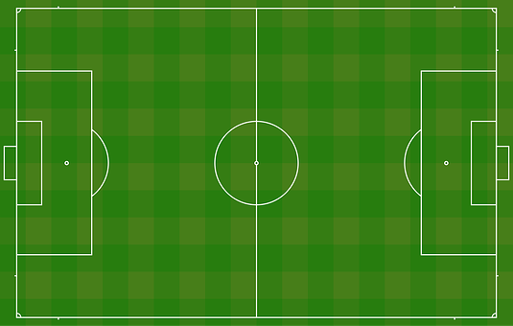
Scenario 1
Arrange Time
Reserve field
Open FFR Application
Search field
Return list of fields
Choose field, time frame then pay
Reserve
3.Return list of fields
5. Reserve
FFR System
2. Search field
4. Choose field, time frame then pay
1. Open FFR Application
83

Slide 84
Scenario 1
Arrange Time
Reserve field
Open FFR Application
Search field
Return list of fields
Choose field, time frame then pay
Reserve
Return result
Send notification
3.Return list of fields
5. Reserve
FFR System
2. Search field
4. Choose field, time frame then pay
7. Send notification
6. Return result
1. Open FFR Application
84

Slide 85
Algorithms
How to find suitable opponent?
Address: 297, Cộng Hòa, phường 4, quận Tân Bình
Free time: 15:00 – 17:00
Duration: 2 hour
Field Type: 5 vs 5
Rating point: 85
Search radius: 5 km
Mr.Thành
Mr. Thành needs to find opponent to play football
85

Slide 86
Solutions
How to match opponent and create a match?
86

Slide 87
Solutions
How to match opponent and create a match?
Find suitable opponent
Find suitable field
87

Slide 88
Scenario 3
How to find suitable opponent?
Address: 297, Cộng Hòa, phường 4, quận Tân Bình
Free time: 14:00 – 17:00
Duration: 2 hour
Field Type: 5 vs 5
Rating points: 85
Search radius: 5 km
Mr.Thành
88

Slide 89
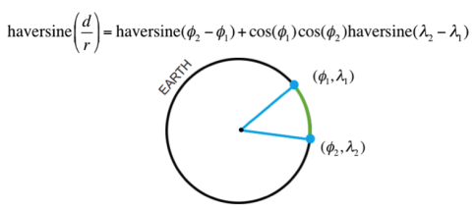
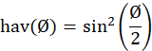
Algorithms
Calculate distance two points with Haversine
d is the distance between the two points
r is the radius of the sphere,
φ₁, φ₂: latitude of point 1 and latitude of point 2, in radians
λ₁, λ₂: longitude of point 1 and longitude of point 2, in radians
89

Slide 90
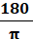
Algorithms
Calculate distance two points with Haversine
Note that φ and λ can be converted from radians to degrees by multiplying by
The latitude of Ho Chi Minh City, Vietnam is 10.762622, and the longitude is 106.660172.
Let latitude1 = latitude2 = 10.76, d = 5(km), r = 6.367.449(m)
longitude2 = longitude1 ± 0.0455 (in decimal)
Let longitude1 = longitude2, d=5 (km), r = 6.367.449(m)
latitude2 = latitude1 ± 0.045 (in decimal)
90

Slide 91
Algorithms
Calculate distance two points with Haversine
A₁ (x - a, y + b)
A₂ (x + a, y + b)
x: latitude of A
y: longitude of A
a: deviation of latitude
b: deviation of longitude
5 km
A (x, y)
5 km
A₃ (x - a, y - b)
A₄ (x + a, y - b)
91

Slide 92
Algorithms
Calculate distance two points with Haversine
A₁ (x - a, y + b)
A₂ (x + a, y + b)
x: latitude of A
y: longitude of A
a: deviation of latitude
B: deviation of longitude
5 km
A (x, y)
5 km
A₃ (x - a, y - b)
A₄ (x + a, y - b)
92

Slide 93
Algorithms
Find suitable opponent
300, Trường Chinh, phường 5, quận Tân Bình
Free time: 14:00 – 19:00
Duration: 2 hour – Field type: 5 vs 5
Rating point: 150
Search radius: 5 km
175, Hồ Văn Huê, phường 3, quận Phú Nhuận
Free time: 13:00 – 17:00
Duration: 2 hour – Field Type: 5 vs 5
Rating point: 90
Search radius: 7 km
Mr.Huấn
Mr.Hiếu
500 Thoại Ngọc Hầu, Quận Tân Bình
Free time: 10:00 – 17:00
Duration: 3 hour - Field type: 5 vs 5
Rating point: 80
Search radius: 5 km
Mr.Quý
Mr.Thành
1. Based on distance criteria: System founds matching requests of Mr. Huấn, Mr. Hiếu. Mr. Quý.
93

Slide 94
Algorithms
Find suitable opponent
Free time: 14:00 – 19:00
Duration: 2 hour
Field type: 5 vs 5
Rating point: 150
Blacklist: Mr.Quý
Free time: 10:00 – 17:00
Duration: 3 hour
Field type: 5 vs 5
Rating point: 80
Blacklist: No
Free time: 13:00 – 17:00
Duration: 2 hour
Field Type: 5 vs 5
Rating point: 90
Blacklist: No
Mr.Huấn
Mr.Quý
Mr.Hiếu
Mr.Thành
Free time: 15:00 – 17:00
Duration: 2 hour
Field Type: 5 vs 5
Rating point: 85
Blacklist: No
94

Slide 95
Algorithms
Find suitable opponent
Free time: 14:00 – 19:00
Duration: 2 hour
Field type: 5 vs 5
Rating point: 150
Blacklist: Mr.Quý
Free time: 10:00 – 17:00
Duration: 3 hour
Field type: 5 vs 5
Rating point: 80
Blacklist: No
Free time: 13:00 – 17:00
Duration: 2 hour
Field Type: 5 vs 5
Rating point: 90
Blacklist: No
Mr.Huấn
Mr.Quý
Mr.Hiếu
2. Based on field type and time
Have same field type
Duration of opponent must be less than or equal duration of Mr.Thành
Mr.Thành
Free time: 15:00 – 17:00
Duration: 2 hour
Field Type: 5 vs 5
Rating point: 85
Blacklist: No
Free time: 14:00 – 19:00
Duration: 2 hour
Field type: 5 vs 5
Rating point: 150
Blacklist: Mr.Quý
Free time: 13:00 – 17:00
Duration: 2 hour
Field Type: 5 vs 5
Rating point: 90
Blacklist: No
Mr.Huấn
Mr.Hiếu
95

Slide 96
Algorithms
Find suitable opponent
Free time: 14:00 – 19:00
Duration: 2 hour
Field type: 5 vs 5
Rating point: 150
Blacklist: Mr.Quý
Free time: 13:00 – 17:00
Duration: 2 hour
Field Type: 5 vs 5
Rating point: 90
Blacklist: No
Mr.Huấn
Mr.Hiếu
3. Based on field type and time
Difference rating point is not exceed 50 points
Mr.Thành
Free time: 15:00 – 17:00
Duration: 2 hour
Field Type: 5 vs 5
Rating point: 85
Blacklist: No
Free time: 13:00 – 17:00
Duration: 2 hour
Field Type: 5 vs 5
Rating point: 90
Blacklist: No
Mr.Hiếu
96

Slide 97
Algorithms
Find suitable opponent
Free time: 13:00 – 17:00
Duration: 2 hour
Field Type: 5 vs 5
Rating point: 90
Blacklist: No
Favorites Field: No
Mr.Thành
Free time: 15:00 – 17:00
Duration: 2 hour
Field Type: 5 vs 5
Rating point: 85
Blacklist: No
Favorites Field: Sân bóng đá Âu Cơ
Mr.Hiếu
Free time of Mr.Hiếu is longer than Free time of Mr.Thành
=> Mr.Thành is selected times to play. 15h – 17h
97

Slide 98
Algorithms
How to find suitable field for two opponent?
+ Search for field in the search radius requested by two users, the returned list contain common field of two lists found.
+ If there are common favorites field of two user or one of two users in return list, system will only recommend these fields.
+ If there is no favorites field of any user in return list, system will return all returned list
98

Slide 99
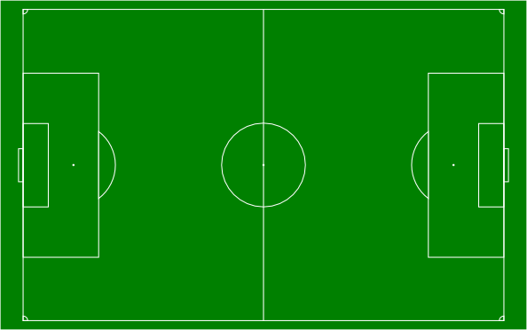
For players
Find suitable opponent
Sân bóng đá mini Chảo lửa
15h – 17h
180.000 VNĐ
Mr.Hiếu
Sân bóng đá Lạc Long Quân
15h – 17h
200.000 VNĐ
VS
Sân bóng đá Âu Cơ
15h – 17h
210.000 VNĐ
Mr.Thành
Mr.Hiếu
99

Slide 100
For players
Find suitable opponent
Sân bóng đá mini Chảo lửa
15h – 17h
180.000 VNĐ
Mr.Hiếu
Sân bóng đá Lạc Long Quân
15h – 17h
200.000 VNĐ
VS
Mr.Thành
Mr.Hiếu
100

Slide 101
For players
Find suitable opponent
Mr.Hiếu
VS
Mr.Thành
Mr.Hiếu
Sân bóng đá mini Chảo lửa
15h – 17h
180.000 VNĐ
101

Slide 102
Algorithms
Calculating rating bonus point
User who creates an account will have default rating point = 100.
Calculating rating score based on rating of user after match.
Check rating result from two users for verification.
1. Match has winner:
+ Winner’s rating score = winner’s current rating score + 30 points + difference goals.
+ Loser’s rating score = loser’s current rating score – difference goals.
2. Draw match:
User’s rating score = current rating score + 10 points.
Ex: Mr. Thành has rating point = 120 vs Mr. Huấn has rating point = 80.
Mr. Thành is the loser after match with difference goals = 4 goals.
Mr.Thành’s rating score = 120 – 4 = 116.
Mr. Huấn’s rating score = 80 + 30 + 4 = 114.
102

Slide 103
Scenario 2
Match opponent
1. Open FFR application
2. Search then choose opponent
Mr. Thành
Mr. Quý
4. Set time frame
then reserve
3. Choose field
Ms. Linh
103
Notes:
Story: Mr.Thành muốn tìm kiếm đối thủ cho đội bóng của mình.
Đầu tiên: Thành sử dụng điện thoại có cài đặt app FFR.
Tiếp theo: Khi yêu cầu hệ thống tìm đối thủ, Quý có trong danh sách phù hợp với yêu cầu của Thành do hệ thống gợi ý. Thành chọn Quý làm đối thủ của mình.
Kế đến, THành lựa chọn sân của chủ sân Linh – là một trong những sân phù hợp với yêu cầu của cả 2
B3: Cuối cùng, Sau khi chọn sân, Thành cài đặt thời gian theo khung giờ rảnh của sân, trả tiền rồi đặt sân.

Slide 104
Scenario 2
Match opponent
Open FFR Application
Send matching request
FFR System
2. Send matching request
1. Open FFR Application
104

Slide 105
Scenario 2
Match opponent
Open FFR Application
Send matching request
Return opponent list
3.Return opponent list
FFR System
2. Send matching request
1. Open FFR Application
105

Slide 106
Scenario 2
Match opponent
Open FFR Application
Send matching request
Return opponent list
Choose opponent
3.Return opponent list
FFR System
2. Send matching request
4.Choose opponent
1. Open FFR Application
106

Slide 107
Scenario 2
Match opponent
Open FFR Application
Send matching request
Return opponent list
Choose opponent
Return field list
3.Return opponent list
FFR System
2. Send matching request
4.Choose opponent
5. Return field list
1. Open FFR Application
107

Slide 108
Scenario 2
Match opponent
Open FFR Application
Send matching request
Return opponent list
Choose opponent
Return field list
Choose field then pay
6. Choose field then pay
FFR System
108

Slide 109
Scenario 2
Match opponent
Open FFR Application
Send matching request
Return opponent list
Choose opponent
Return field list
Choose field then pay
Reserve
7. Reserve
6. Choose field then pay
FFR System
109

Slide 110
Scenario 2
Match opponent
Open FFR Application
Send information
Return opponent list
Choose opponent
Return field list
Choose field then pay
Reserve
Send notification to field owner
Send notification to opponent
Return result
7. Reserve
6. Choose field then pay
FFR System
9. Send notification to opponent
8. Send notification to field owner
10. Return result
110

Slide 111
Process
Demo
111

Slide 112

Values
For field owner:
Field owner can manage timeline of field more effective.
Field owner can attract users in idle times by setting discount price, free services for each time frame.
112

Slide 113
Values
For User:
Reservation transaction is proceeded online easily and quickly.
Users can find opponents with the matching system.
113

Slide 114

Challenge
The application depends on user’s behaviors.
Have difficult when we persuade Field Owner to use FFR System.
114

Slide 115
Part 4
Future Plan

Slide 116
Future Plan
Build Mobile Application for Field Owner.
Allow user to pay by multiple payment gateways.
Extend interaction with many Field Owner outside Ho Chi Minh City
116

Slide 117
Thanks you for listening!
Q & A

